Slide 1

Imitation Learning: Behavioral Cloning and DAgger
Social Robotics – Academic Year 2023-24
Giovanni Brunelli
Paolo Magri

Slide 2
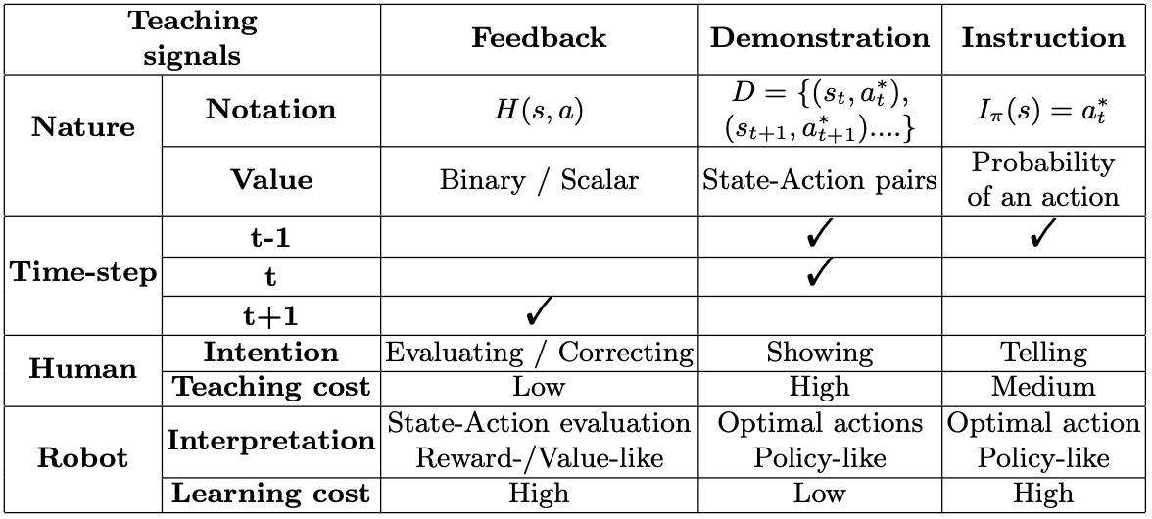
How to teach robots to perform tasks?
Note: The robot action is performed at time-step t

Slide 3
How to teach robots to perform tasks?
Correcting
Showing
Telling

Slide 4

Learning from Demonstration (LfD)
Showing
Easy for non-expert users in robot-programming
Adaptability of training models for complex tasks
Significant human Demonstration effort
Limitation in environment exploration
Dependency on Demonstration quality

Slide 5
Learning from Demonstration (LfD)
Showing
Easy for non-expert users in robot-programming
Adaptability of training models for complex tasks
Significant human Demonstration effort
Limitation in environment exploration
Dependency on Demonstration quality
Set of demonstrations
=
Human policy of the task

Slide 6
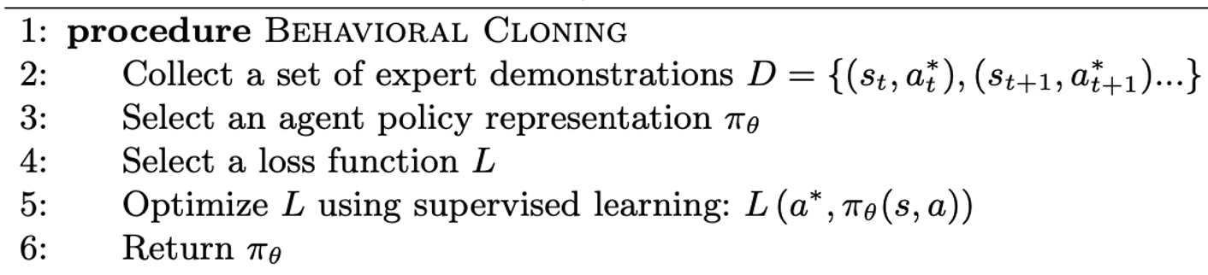
Behavioral Cloning
Mimicking Expert’s behavior
Supervised Learning paradigm
Single stage training

Slide 7
Behavioral Cloning: Limitations
Rigidity
Error Propagation
Lack of Exploration
…
Epoch 498/500, Loss: 0.5862, Accuracy: 75.00%
Epoch 499/500, Loss: 0.6352, Accuracy: 68.75%
Epoch 500/500, Loss: 0.6480, Accuracy: 70.83%

Slide 8
Introduction to DAgger
Adaptability & Generalization:
Iterative Learning
WIder Scenario Coverage
Reduction in Distribution Shift:
Diverse Data Inclusion
Improved Robustness
Interactive Learning from Human Feedback:
Continuous Feedback Loop
Policy Refinement Over Time
Exploration & Error Correction:
Action Space Exploration
Error Correction Mechanism
Enhanced Performance Over Iterations:
Continuous Improvement
Versatility in Dynamic Environments

Slide 9
Introduction to DAgger
Interactive Learning from Human Feedback:
Continuous Feedback Loop
Policy Refinement Over Time
Online Imitation Learning

Slide 10
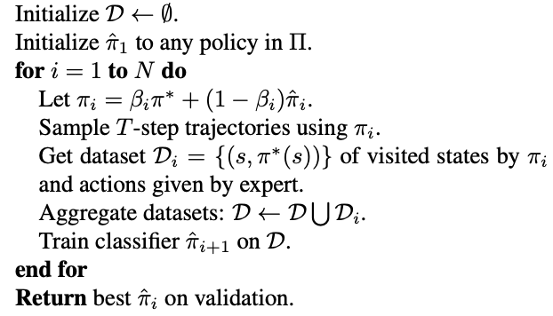
DAgger Algorithm
After each iteration, the model is used to generate new data by interacting with the environment;
The expert provides additional demonstrations on the newly generated data;
The dataset is aggregated, and the model is trained on this combined dataset;

Slide 11
DAgger Algorithm
After each iteration, the model is used to generate new data by interacting with the environment;
The expert provides additional demonstrations on the newly generated data;
The dataset is aggregated, and the model is trained on this combined dataset;

Slide 12
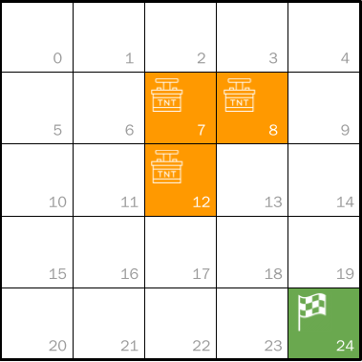
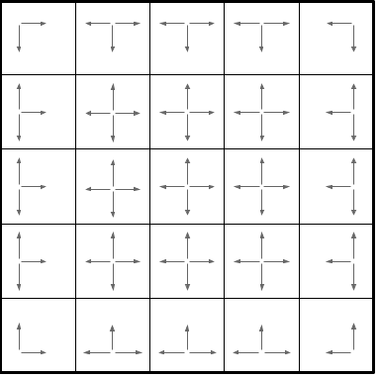
The Environment
# Define transitions for each action (move in the grid)
if action == 0: # Up
next_position = (max(0, self.state // self.grid_size[1] - 1), self.state % self.grid_size[1])
elif action == 1: # Down
next_position = (min(self.grid_size[0] - 1, self.state // self.grid_size[1] + 1), self.state % self.grid_size[1])
elif action == 2: # Left
next_position = (self.state // self.grid_size[1], max(0, self.state % self.grid_size[1] - 1))
elif action == 3: # Right
next_position = (self.state // self.grid_size[1], min(self.grid_size[1] - 1, self.state % self.grid_size[1] + 1))

Slide 13
Dataset Generation
The dataset of expert demonstrations is rapresented as a state-action pairs (s, a):
Expert Demonstration 1: [(16, 3), (17, 3), (18, 3), (19, 1)];
Expert Demonstration 2: [(8, 3), (9, 1), (14, 1), (19, 1)];
Expert Demonstration 3: [(17, 3), (18, 3), (19, 1)];
Expert Demonstration 4: [(0, 3), (1, 3), (2, 3), (3, 1), (8, 3), (9, 1), (14, 1), (19, 1)];
Expert Demonstration 5: [(7, 3), (8, 3), (9, 1), (14, 1), (19, 1)];
…

Slide 14
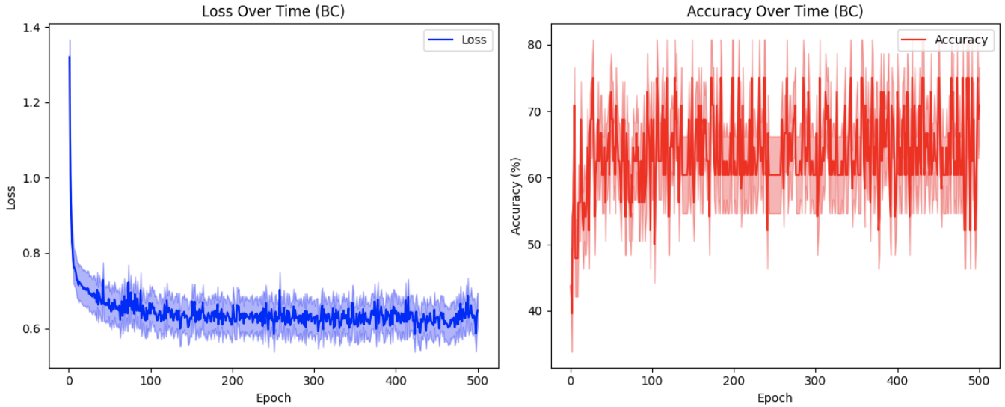
Comparison: BC VS DAgger

Slide 15
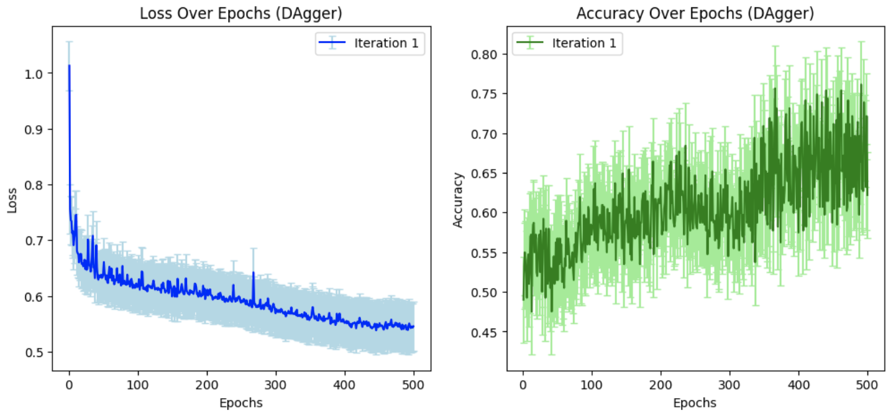
Comparison: BC VS DAgger

Slide 16
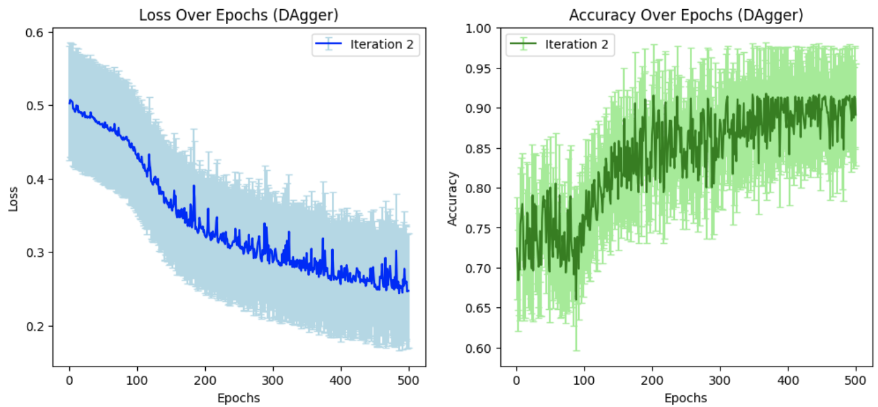
Comparison: BC VS DAgger

Slide 17
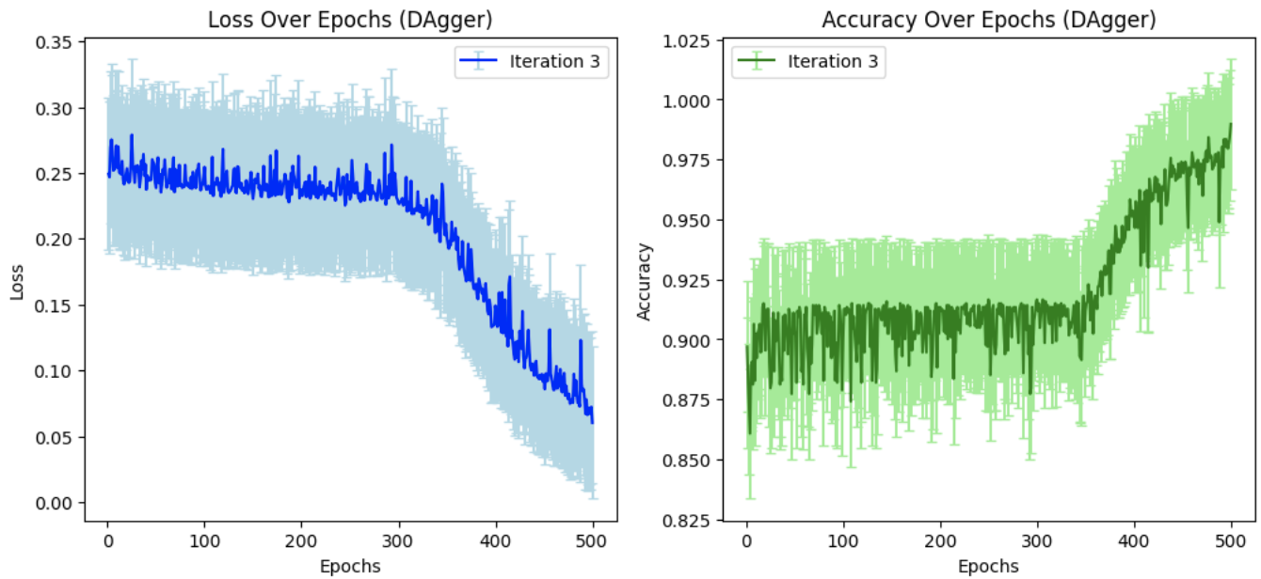
Comparison: BC VS DAgger

Slide 18
Offline VS Online Imitation Learning
Offline Imitation Learning → Pre-defined Expert Demonstrations

Slide 19
Offline VS Online Imitation Learning
Offline Imitation Learning → Pre-defined Expert Demonstrations
Online Imitation Learning → Human-Feedback

Slide 20
Offline VS Online Imitation Learning
Offline Imitation Learning → Pre-defined Expert Demonstrations
Online Imitation Learning → Human-Feedback
Learning from Demonstrations → Online DAgger → Learning from Feedback

Slide 21
Thanks for the kind attention
Questions?

